Slide 1
Erosion and loss of transitional protection in Universal Credit
Notes:
---
This presentation addresses the erosion and loss of transitional protection within the Universal Credit system. We will explore its structure, the concept of transitional protection, the factors leading to its erosion, its consequences, and potential strategies to mitigate this issue.

Slide 2
  Why did my benefits not increase in April ?
  I was awarded LCWRA but did not get any extra in my UC !
  I had another child and got no extra payment for this ?

Slide 3
Introduction
  Transitional protection in Universal Credit is an additional payment designed to ensure individuals aren't financially worse off when transitioning from legacy benefits to Universal Credit. It's essentially a top-up payment that maintains their income at the level they received from their previous benefits.
  Transitional protection is primarily available to individuals who receive a Migration Notice and claim Universal Credit by the deadline date specified in the notice.
  It is not time-limited, but it will gradually decrease as your Universal Credit entitlement increases, either through normal upratings or changes in your circumstances.
  The terms "transitional protection" and "transitional element" in the context of Universal Credit (UC) are essentially interchangeable.

Slide 4
What kinds of transitional protection are we talking about
  Transitional element in managed migration
  Transitional SDP element (primarily for individuals who were previously claiming a legacy benefit that included a Severe Disability Premium) - see ‘Advice for Decision Makers (ADM) Chapter M6: Effects of transition to UC ADM M6766-M6767’

Slide 5
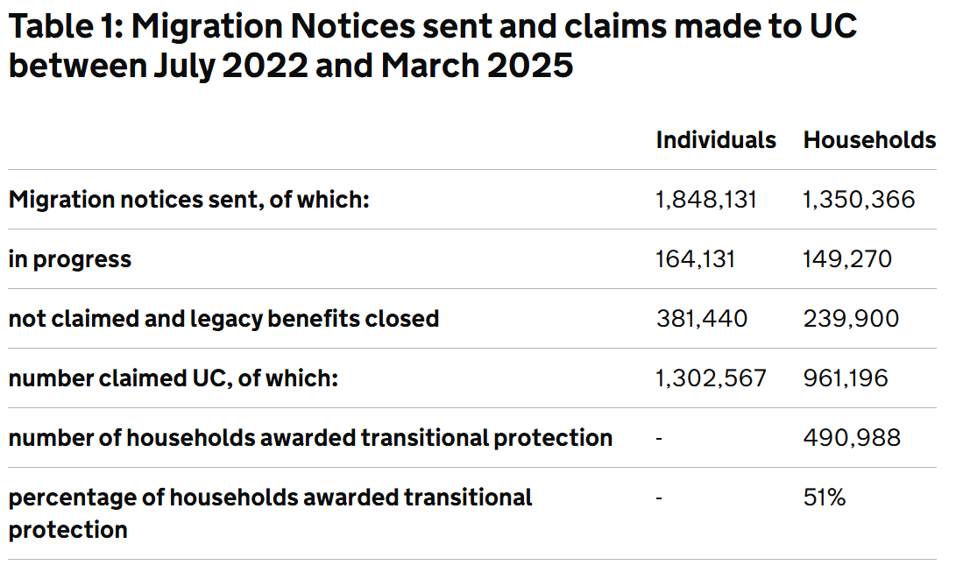

Slide 6
CPAG tools and templates

Slide 7

Getting journal entries and statements from your online universal credit account
Where to find your universal credit online journal entries and statements, and how to download them into a PDF so that you can send them to your adviser.
An adviser would need the following information:
a copy of the entries in your universal credit online journal
a copy of your universal credit statement(s) showing how your universal credit has been calculated
This page explains where to find this information and how to download it from your universal credit online account into a PDF so that you can send it to your adviser -
cpag.org.uk/welfare-rights/tools-templates/getting-journal-entries-and-statements-your-online-universal-credit-account

Slide 8
Request a breakdown of the calculation of a universal credit transitional element
If you have been transferred to universal credit under the managed migration process, use this tool to help you request a breakdown of the calculation of the transitional element. It creates a note for you to add to your universal credit (UC) online journal asking for this.
Carefully check and edit the note as appropriate, removing anything which is not appropriate or relevant, You can do this by copying and pasting the note into a Word file to edit it. When you are happy with the note, copy and paste it into your journal in your online UC account.
Request a breakdown of the calculation of a universal credit transitional element

Slide 9
Advice line for advisers
Free, independent, expert, up-to-date advice and information for frontline advisers and support staff on all aspects of the benefits system.
Phone: 0141 552 0552
Monday to Thursday, 10am - 4pm, Friday 10am - 12 noon
Email: advice@cpagscotland.org.uk
The CPAG advice line is for welfare rights advisers, student advisers, housing staff, health staff, family support staff, social workers, solicitors and other advisers and frontline support staff who do not charge for their services. They cannot advise members of the public.

Slide 10
Erosion

Slide 11
What is erosion?
Erosion means that when another element of UC increases in value or a new element is awarded the transitional element is reduced by the same amount with limited exceptions.
Erosion can’t happen in the first assessment period, only in the
second or later assessment period.
Once eroded, the transitional element can’t be increased/restored. Advice for Decision Makers (ADM M7501-M7502) includes some examples.

Slide 12
Picturing erosion
New element (LCWRA etc)
Transitional payment
Transitional payment
New element (extra child etc)
New element (extra child etc)
Total legacy benefits (ESA, Tax Credits etc)
Other UC elements
Other UC elements
Other UC elements

Slide 13
Example
Donna claims UC as a single claimant.
Her UC includes the TSDPE of £120.
Six months after moving onto UC, two changes occur within the same assessment period. She becomes responsible for her granddaughter – so a Child Element of £292.81 is added and she loses her LCWRA on re-assessment.
The DWP will look at the actual increase – ie the full amount of the new Child Element. They will not take account of the loss of the LCWRA Element.
Her Transitional element is completely eroded 😥

Slide 14
Picturing Donna’s erosion
Total legacy benefits
Work-related activity
£120 Transitional payment
£292.81 Child element
SDP
UC elements (inc. LCWRA)
UC elements (no LCWRA)
ESA

Slide 15
What’s so bad about erosion?
Erosion doesn’t (usually) reduce your income – but it can prevent your UC going up when it otherwise would, or by as much as it otherwise would.
You may find yourself in new circumstances, with higher costs to pay, but the same amount of UC.

Slide 16
Erosion: exceptions
The childcare costs element is ignored. Getting a new/higher childcare costs element does not cause erosion.
If you previously got the LCW element and have now been awarded the LCWRA element, your transitional element is eroded by the difference between the two.
Recent case law says it’s unlawful for your transitional element to be eroded if you get a housing costs element for the first time on moving from specified/temp accommodation to general needs accommodation (SSWP v JA [2024] UKUT 52(AAC)).

Slide 17
Triggers

Slide 18
Which triggers end the transitional element immediately?
Reg 56 of the UC(TP) Regs:
  Single to couple
    Form new couple (unless still claiming UC as single person – eg, partner is in prison/has NRPF)
  Couple to single
    You are claiming Universal Credit as a couple but then split up or your partner dies.

Slide 19
Which triggers end the transitional element immediately?
The ‘earnings go down’ rule
  If earnings for a Universal Credit claimant with transitional protection fall below a specific threshold for three consecutive assessment periods, the transitional protection will end.
  This threshold is based on the Administrative Earnings Threshold (AET) at the start of the claim. If earnings then drop below the AET, the transitional protection will be lost (AET is £952 for single claimant, £1,534 for a couple).

Slide 20
Which triggers end the transitional element immediately?
UC ends (with the ‘earnings go up’ exception), even if you can reclaim it later.
  The exception to this is where UC ends because earnings are too high, and you become entitled again within three months from last day of relevant assessment period. In this case, transitional element is reinstated.
  Reg 57(1) – Transitional protection not applied to subsequent awards
  Reg 57(2) - Exception where award ends due to earnings and new claim made within 3 months

Slide 21
Revise or challenge?

Slide 22
Two approaches when considering a case involving erosion
Check whether the decision can be revised rather than superseded.
  A revision or Mandatory Reconsideration is a formal process to reconsider a decision, potentially leading to a changed outcome.
  A supersession is a way of changing a benefit decision from the date a change occurred, rather than the original date of the decision. It's a way to address a Universal Credit award if a change in circumstances or an error in the original decision is identified. To request a supersession for a Universal Credit decision, you should notify the DWP explaining why you believe the original decision is incorrect and needs to be reviewed.
Challenge the application of the regs. Have they applied the regulations correctly?

Slide 23

Secretary of State for Work and Pensions v MJ

Slide 24
Erosion – Carers Element and LCWRA
PRIOR TO THE TEST CASE - If LCWRA replaced a carer element you could have been particularly worse off. Your transitional element was eroded by the full value of the LCWRA, plus you lose your carer element.
The Upper Tribunal accepted that MJ was:
Treated less favourably than someone who is not a carer who subsequently gets LCWRA; and
Treated less favourably than someone who is receiving a transitional element and has LCWRA, who subsequently becomes a carer.

Slide 25
Example
Jane is 28 years old and lives alone in her own tenancy
 | Previous UC entitlement | Client awarded LCWRA | Prior to MJ case | After MJ case
Standard allowance | 400.14 |  | 400.14 | 400.14
Carers Element | 201.68 |  | Removed | Removed
LCWRA | - |  | 423.27 | 423.27
Transition element | 400.00 |  | Removed | 178.41*
Total UC | 1001.82 |  | 823.41 | 1001.82
*Transition element is eroded by the difference between the Carer’s Element and the LCWRA element.

Slide 26
What can claimants in a similar position do?
The SSWP had three months from 10 February 2025 to apply for permission to appeal to the Court of Appeal from the Upper Tribunal – they haven’t 😀
The effect of the decision in SSWP v MJ [2025] UKUT 035 (AAC) may depend on the stage a claimant’s case was at on 29 January 2025 (the date of the Upper Tribunal’s decision).
Claimants who have already passed through mandatory reconsideration stage or claimants with Carers Element who are accepted as having LCWRA from some date on or after 29 January 2025 should be ok and can make use of this decision.
Claimants whose UC was reduced in a way which SSWP v MJ now makes clear was unlawful, for a period prior to 29 January 2025 or those recognised as having LCWRA only after 29 January 2025 but where entitlement to the LCWRA element would be due to commence from some day before that date would then be, unfortunately, looking at the Judicial Review process.

Slide 27


Slide 28
The Universal Credit (Transitional Provisions) Regulations 2014
The Social Security (Miscellaneous Amendments) Regulations 2025
                See also the Advice for Decision-Making (ADM) guidance for DWP’s interpretation and examples:
Erosion: ADM M7500-M7512
The four triggers that end the transitional element immediately: ADM M7530-M7541
ADM 01-25: Transition to Universal Credit and Pension Credit - Miscellaneous Amendments
Explains the amendments to regs which includes:
The transitional element and the housing costs element (SSWP v JA [2024] UKUT 52 (AAC))
The relevant period and the LCWRA element (PR V SSWP [2023] UKUT 290 (AAC))

