Slide 1
Help to Claim Project

Slide 2

Our aim today
Provide a general overview of what the
Help to Claim Project does
How you can signpost potential clients to our helpline

Slide 3
What is the Help to Claim Project?
Help to Claim is a digital only service
A network of advisers who help via:
    Helpline (0800 023 2581) 8am-6pm Mon-Fri
    Webchat
    BSL via SignVideo
    Interpreters are available
Advisers work within local bureau and remotely
Supported by the HTC team at CAS

Slide 4
What we can help with
We support clients from the beginning of their Universal Credit application until their first full and correct payment. We can:
Check Universal Credit eligibility
Support clients to complete a UC claim (digital or phone claim [DWP priority access])
Prepare for ID and claimant commitment meetings
Check clients first payment to ensure it is correct

Slide 5
Managed Migration
Explain managed migration process
Provide tactical advice on best time to transfer to universal credit
Identify any income maximisation of their legacy benefit
Estimate managed migration calculation
Support clients through migration process dependent on needs
While we do not have face-to-face funding, we can support clients that we can’t assist on the helpline to find alternative support / including through escalations with DWP

Slide 6

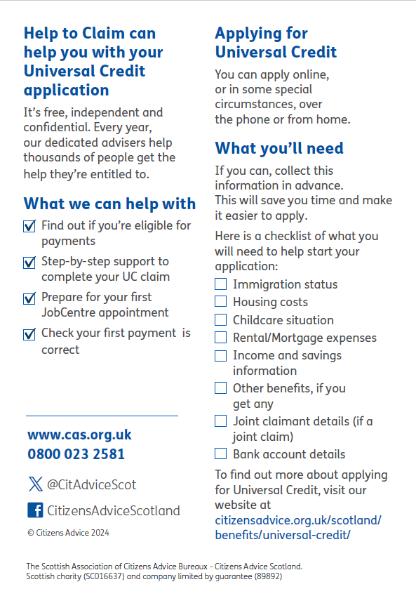

Slide 7
Preparing a client for support
If you believe your client could benefit from the HTC Helpline and they need to start a Universal Credit claim, you can recommend they have the following information ready:
Housing costs
Rental / Mortgage expenses
Details about legacy benefit awards (if applicable)
Income and savings
Bank account details
Childcare situation
Immigration status

Slide 8
Summary
  We can help with:
People who need to make a new Universal Credit application.
People on legacy benefits who need to switch to Universal Credit (Managed Migration).
People who are in the process of applying for Universal Credit and need assistance.
Note: we only have resources to support clients up until their first full and correct payment of UC; UC clients beyond that are out of scope for the HTC service.

Slide 9
Questions
Citizens Advice Scotland Universal Credit Help to Claim Helpline: 0800 0232581
Website: Help to Claim Universal Credit | Citizens Advice Scotland
Facebook
LinkedIn
X (Twitter): @CitAdviceScot
Khira MacWatt, Project Officer
Khira.MacWatt@cas.org.uk
Jonathan Boyd, Project Engagement Officer Jonathan.Boyd@cas.org.uk

